Slide 1

Win Prediction in the First 10 Minutes
Data Analysis
Analysis by Andy Gomez | 08/2021

Slide 2

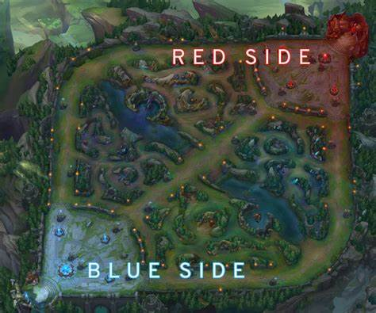
Background – LoL Data
Number of League Games: n=9879
19 features per team (Blue/Red)
Some of the collected metrics include:
Kills
Deaths
Gold
Experience
Level
The target in the data set will be for Blue side wins.
Notes:
League of Legends is a MOBA (multiplayer online battle arena) where 2 teams (blue and red) face off. There are 3 lanes, a jungle, and 5 roles. The goal is to take down the enemy Nexus to win the game.

Slide 3
Executive Summary – TL;DR
Overall Trends found for Blue Wins
Games that have Blue Side wins have more games with minion kills over 217 than Blue side losses
Those with Blue Side Wins have higher Total Gold values
A strong correlation (.86) can be seen by Red Side Gold Difference and Experience Difference
After testing several predictive models and running the ideal parameters for each model (KNN, Bagging Regressor, Random Forest Regressor):
Linear Regression produced the strongest test R^2 value of .51
Bagging Regressor had a test R^2 score of .250 and Random Forest Regressor had a score of .246 (Note: these two predictive methodologies used train-test-split)

Slide 4
Recommendations
Actionable Items
Focusing on getting more minions kills will increase overall gold which can increase the likelihood of blue side winning
Using Linear Regression to help predict Blue Side wins would be a better model to use over other regression predictive models. However, the testing R^2 is still not ideal so other methods can be used to determine Blue Side wins

Slide 5

Data

Slide 6
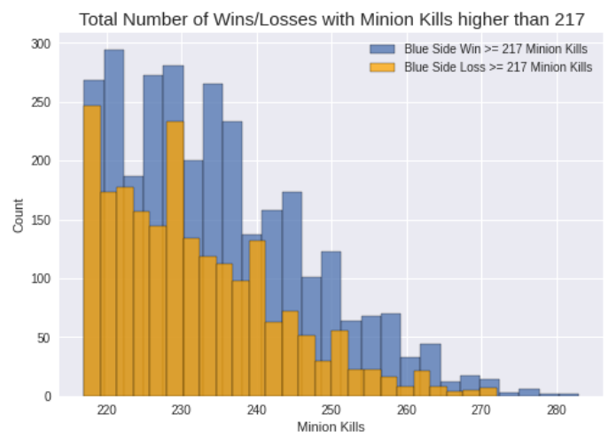


There are more LoL games that have more than 217 Minion kills for those that win on Blue Side

Slide 7
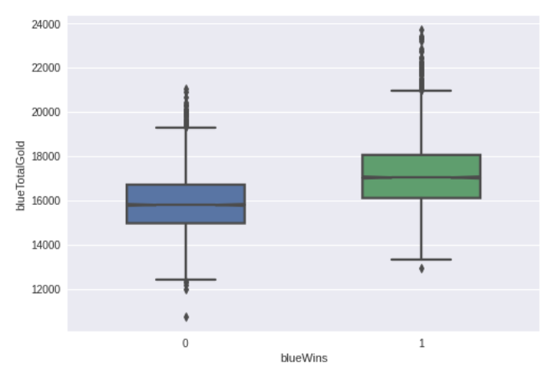
Blue Side Wins demonstrate higher Total Gold values over those that do not win

Slide 8
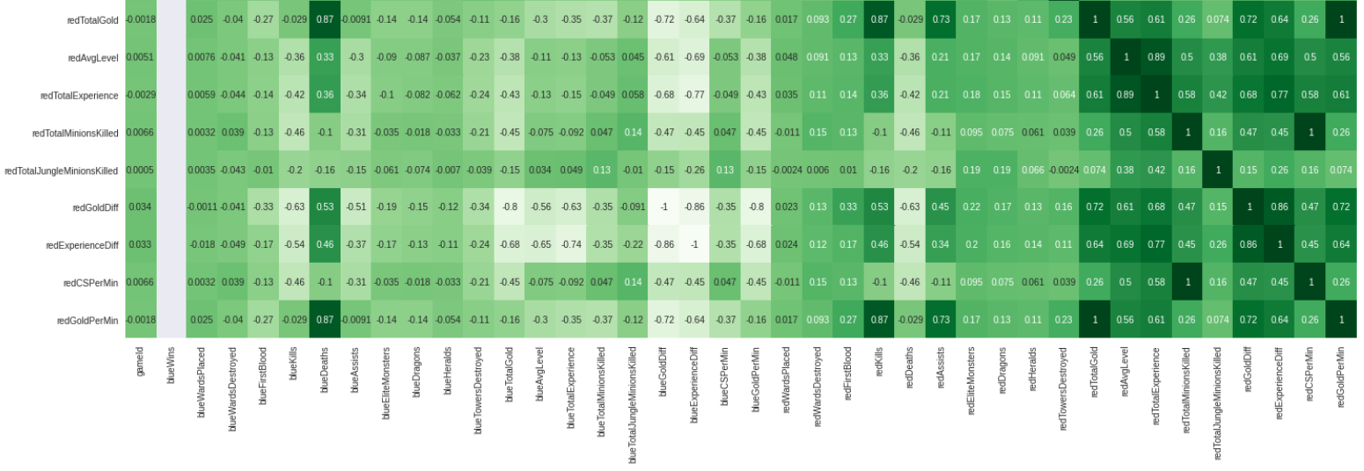
Red Side Gold Difference and Experience Difference have a strong positive correlation score of .86
*: Correlation grid was reduced to show 9 features of the 19.

Slide 9
Linear Regression is seen to be a stronger predictive model for Blue Side Wins when compared to other Regressor models
Linear Regression Score
R^2 = .283
Bagging Regressor Scores | Random Forest Regressor Scores
Train R^2 = .90 | Train R^2 = .90
Test R^2 = .250 | Test R^2 = .246

